Slide 1
A Review of the Course
Geoff Hulten

Slide 2
Ensemble Overview
Bias / Variance challenges
Simple models can’t represent complex concepts (bias)
Complex models can overfit noise and small deltas in data (variance)
Instead of learning one model, learn several (many) and combine them
Easy (low risk) way to mitigate some bias / variance problems
Often results in better accuracy, sometimes significantly better

Slide 3
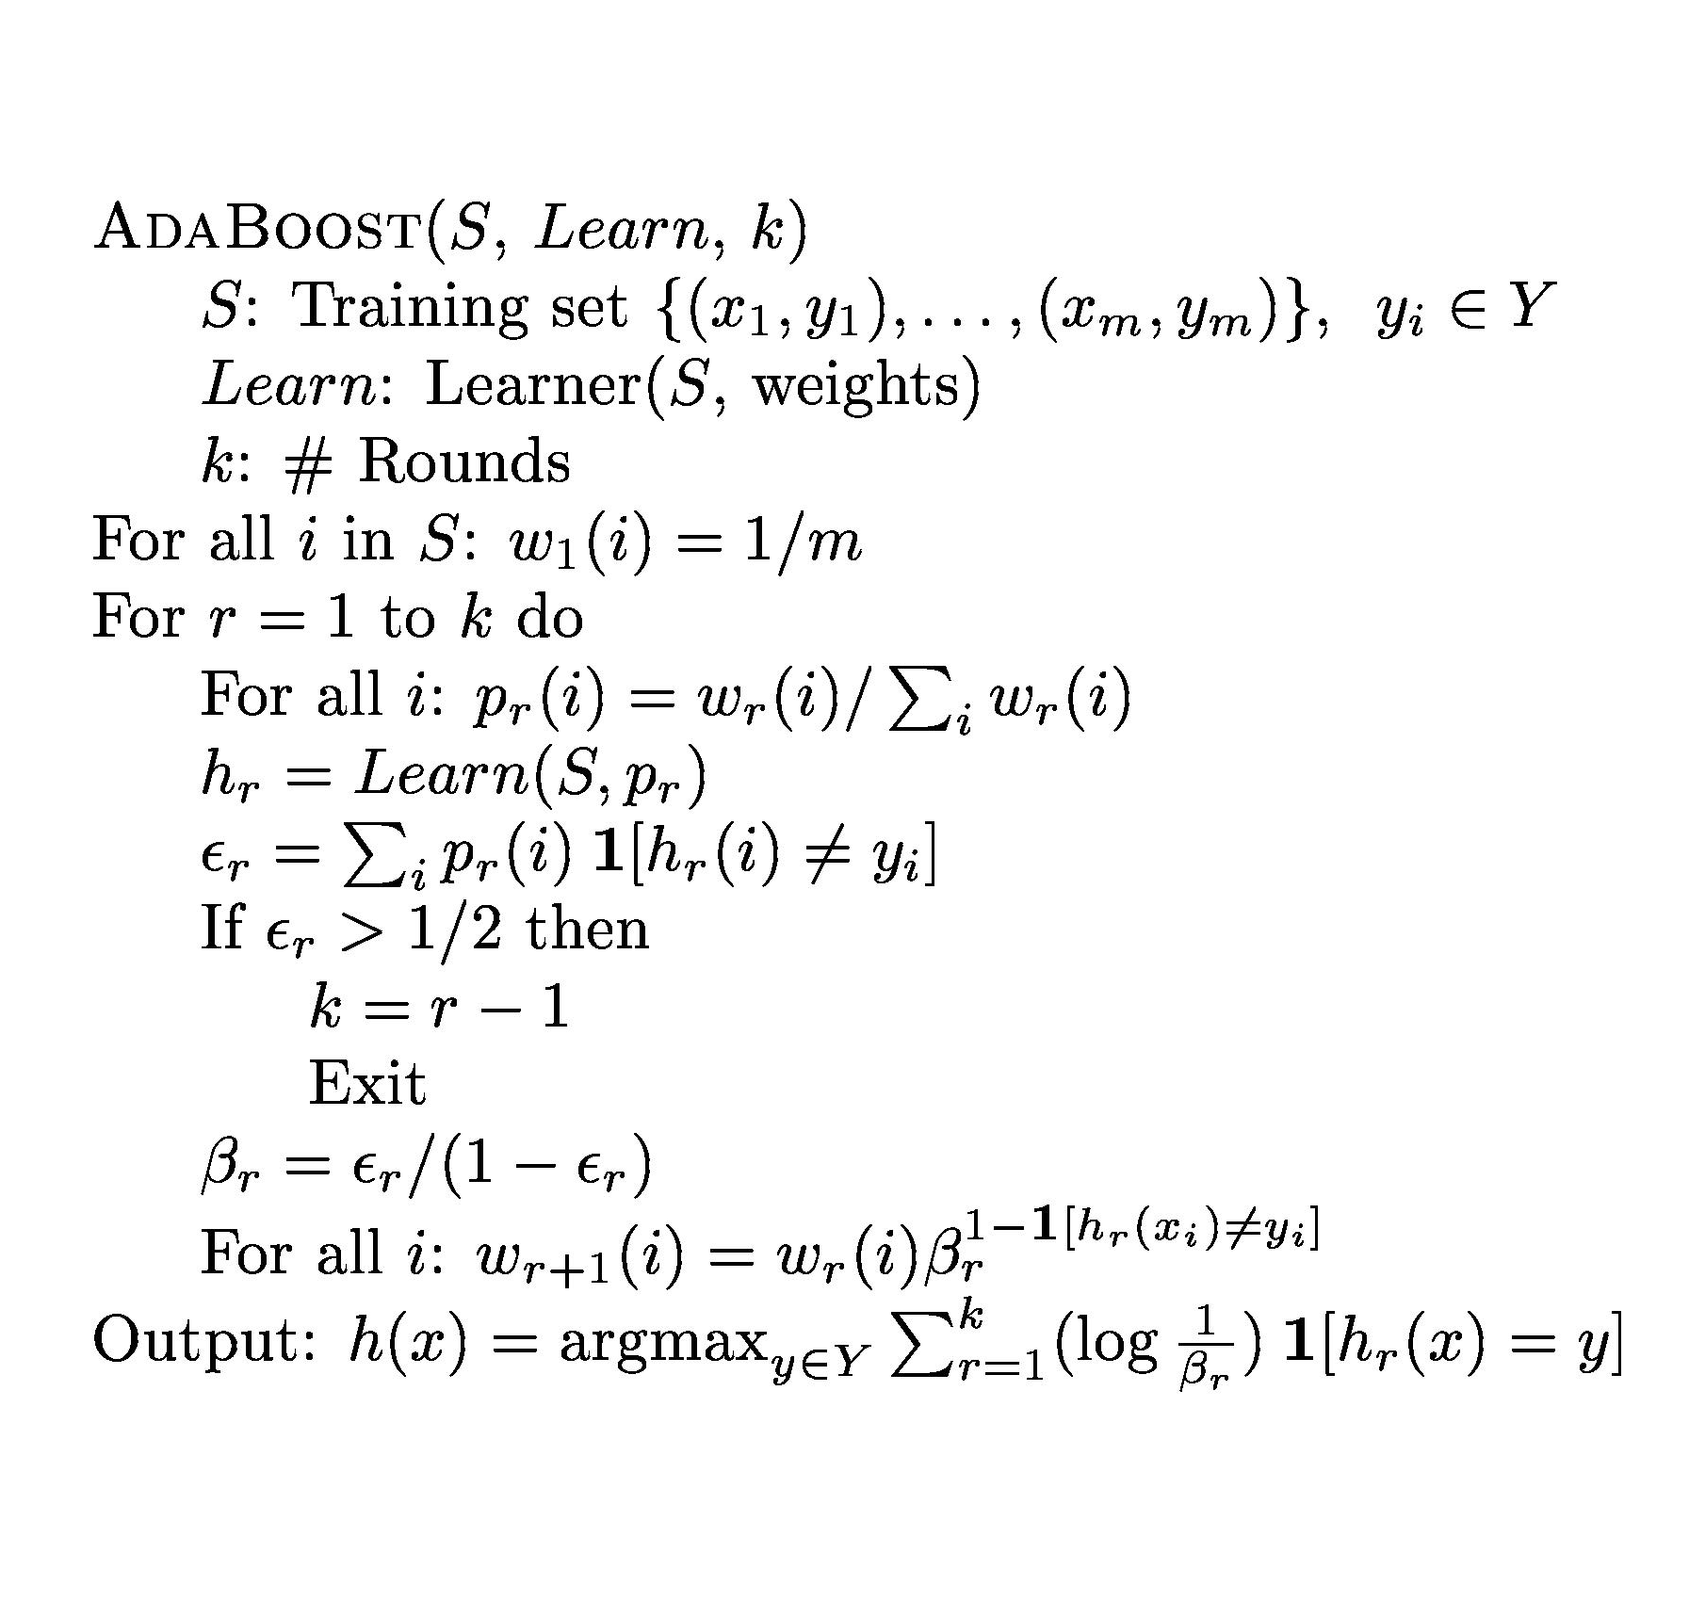
AdaBoost Algorithm
Normalize training set weight (sum to 1)
$B_{r}$is error of model $r$
Samples start with
uniform weight
$$β_{r}$$
$$ε_{r}$$
r: round
k: numModels
Learn model
using weightings $p_{r}$
Sample weight multiplied by: 1 if wrong
$β_{r}$if correct
$ε_{r}$is weight of incorrect training samples
Final ensemble, each model votes based on accuracy
High training error means residuals too hard (noisy) to make progress so stop
$$log⁡(\frac{1}{β_{r}})$$
$$β_{r}$$

Slide 4
Stacking
Potentially Different Model Types
$$y_{meta}=y_{original}$$
$$x_{1meta}={Model}_{1}.predict\left(x_{original}\right)$$
$$x_{…meta}={Model}_{…}.predict(x_{original})$$
$$x_{Kmeta}={Model}_{K}.predict(x_{original})$$
Parallel Training
Possible
Decision Tree
Prediction time: run base models then run meta model
Linear Model
Training
Set
…
Meta Training
Set
Apply multiple base learners (e.g.: decision trees, logistic regression, neural nets, etc)
Meta-learner: Features = base learner predictions Labels = labels from original training set
Train meta-learner on holdout data, e.g.: Leave-out-one cross-validation Hold out one sample Train all base learners on remaining data Meta sample produced on hold-out sample Repeat for all training samples
Important!
Neural Network
Base Training
Meta Data
Meta Training

Slide 5
Stacking and Intelligence Organization
As a team accelerator (Kaggle Pattern)
Everyone develops features/models
Each base model hand-tuned for bias/variance
Learned Meta Model
As an algorithm (Stacking) Single feature set Learned Meta Model
Meta Complexity
As a method for combining with business logic Partitioned feature types Hand crafted (or very simple) meta model
As an Intelligence Architecture Everyone develops features/models Each base model hand-tuned for bias/variance Hand crafted (or very simple) meta model
Feature Complexity

Slide 6
Properties of Well Organized Intelligence
Accurate
Easy to Grow
Loosely Coupled
Comprehensible (mistakes)
Measurable (value of)
Supportive of Team

Slide 7
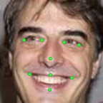
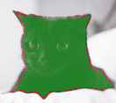
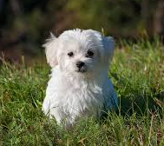
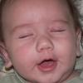
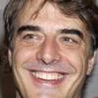
Predictions in Computer Vision
Classification
Localization
Segmentation
Important Points
Cat vs Not-Cat
Cat
Dog
Eye Closed
Eye Opened
Important Points
Eye vs Not Eye

Slide 8
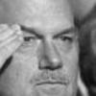
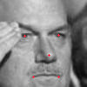
Blink Image Pipeline
Crop Region of Interest
Load
Grey
Localize
Not in Homework Framework
1.0 | 0 | 0
0 | 0.5 | 0
0 | 0 | .25
2.3 | -.5 | -.5
-.5 | .87 | -.5
-.5 | -.5 | .16
Normalize Size 24x24
24x24
Intensity Array
24x24
Normalized Array

Slide 9
Selecting Regions
Whole Image
Regular Grid
Region of Interest
Using Localization
8 Intensity
Features
32 Intensity
Features
8 Intensity
Features
24 Intensity
Features
Combinations
If using:
Avg, Min, Max, 5 histograms
Feature selection:
By region
By feature
By feature type
72 Intensity
Features

Slide 10
Convolutions
3x3 Filter
0 | 0 | 0
-1 | 0 | 1
0 | 0 | 0
Response
0 | 0 | 0 | 0 | 0
0 | 1 | 1 | 0 | 0
0 | 1 | 1 | 0 | 0
0 | 1 | 1 | 0 | 0
0 | 1 | 1 | 0 | 0
0 | 0 | 0 | 0 | 0
Convolve
Intensity Data
0 | 0 | 1 | 1 | 1
0 | 0 | 1 | 1 | 1
0 | 0 | 1 | 1 | 1
0 | 0 | 1 | 1 | 1
0 | 0 | 1 | 1 | 1
0 | 0 | 1 | 1 | 1

Slide 11
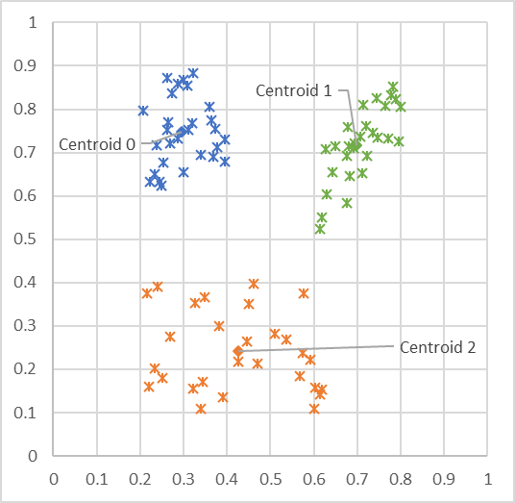
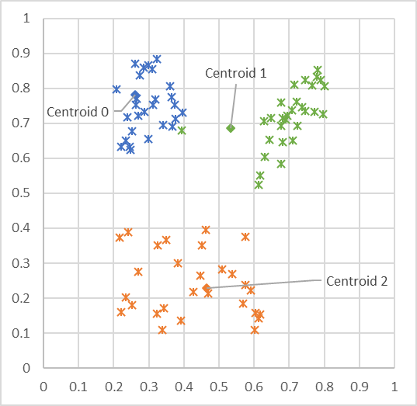
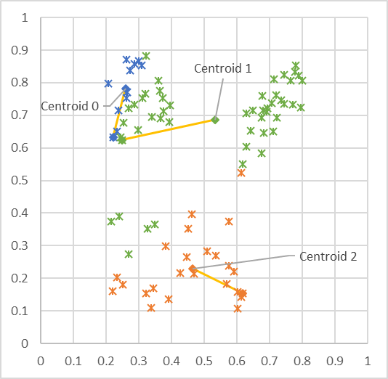
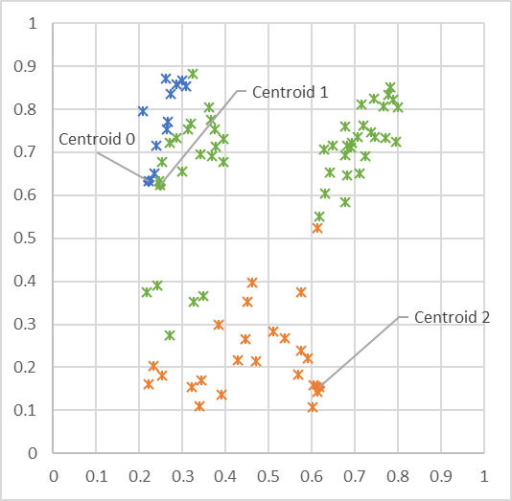
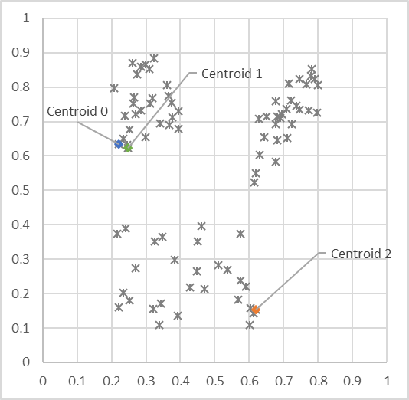
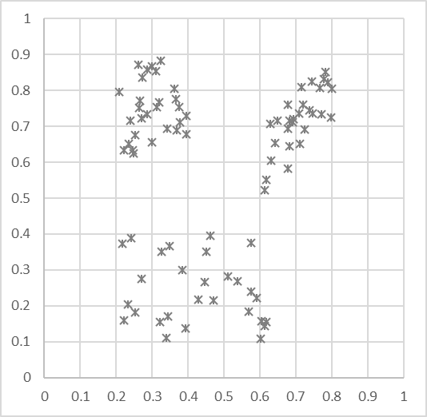
Visualizing K-Means
Unlabled Data
Initialize centroids to random data point locations
Each point assigned to nearest centroid
Update centroid locations to avg of assigned points
Each point assigned to nearest centroid
Update centroid locations to avg of assigned points
Each point assigned to nearest centroid
Converge!
L2 Norm = $\sqrt{d_{1}^{2}+ d_{2}^{2}}$

Slide 12
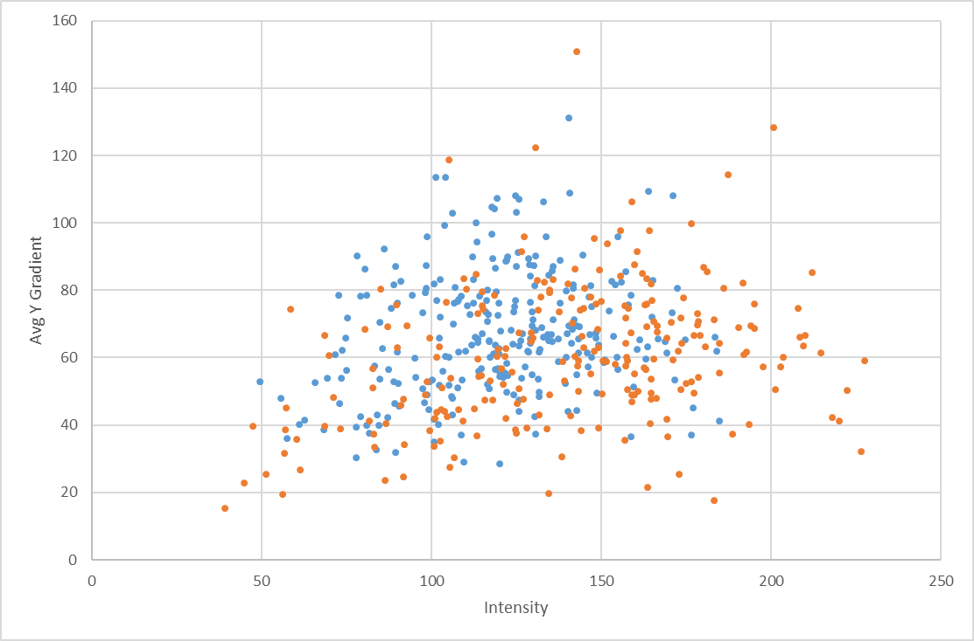
Instance Based Learning – K Nearest Neighbors
Classification technique that uses data as the model
K-Nearest Neighbors – K-NN
Model: the training data
Loss: there isn’t any
Optimization: there isn’t any
To apply, find the K nearest training data point to the test sample
Classify: predict the most common class among them
Probability: predict the distribution of their classes
def predict(xTest):
# for every sample in training set
# compute the distance to xText (using l2 norm)
# find the y values of k closest training samples
# return most common y among these values
# or the % that are 1 for a score…

Slide 13
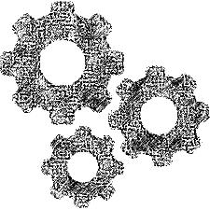
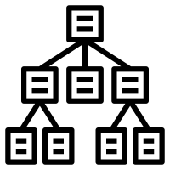
Corpus Centric Learning
Data Collection and Labeling Process
Intelligence Creation Environment
Intelligence Management
Intelligence Runtime
Data Collection
Corpus Centric
Training Corpus
Modeling Process
Data Labeling
Corpus Centric Learning useful When:
Concept is stable
Can’t get data from usage
Don’t have any users
Just not practical given application
Privacy concerns
Need to achieve high quality before initial launch
Limited Telemetry (poor for training)
Disadvantages:
Can be expensive
Labeling not always possible / as good
Not set for automatic ongoing improvement

Slide 14
Labeling Data
Image (label from scratch)
Frame (incremental update)
Multiple Labelers Per Image
- Track Efficiency
- Crosscheck Accuracy
Massive Labeling Task
Imagenet ~1.2M (human level)
10s of thousands (~viable level)
Workflow, quality checking
Tedious, error prone tasks
Consistency key for success
Data useful for many tasks
Label for several at once
Prepare for future
Tedious job…
But can be fun!
Helping to create an AI
Contributing to a neat product
Lable-o-tron 2072
Complete: 12 / 150,232
x
Next
Agreement Index: 87%
Person 1
Draw bounding box…
Draw face bounding box…
Mark hands…
Annotate face…
Enter properties…
Skin Tone…
Has Glasses…
Wearing Makeup…
Gesture start/end…
1
Image or Video Clip
Add Person
Labels for ‘all’ the models

Slide 15
Verifying Model Quality
FPR = 10.1%
Set operating points
Set for worst case not average case
Glasses hardest: set based on this
Per subgroup quality bar
Per subgroup measure FN at target FP
Ensure worst FNR at worst FPR is acceptable
Finding risks
Explore mistakes with a critical eye
Imagine the worst thing that could happen
Set up reporting and prepare to react
FPR = 0.1%
Skin Tone
Makeup
Age < 13
Glasses
Backlight
Core Userbase
Something you never thought of…

Slide 16
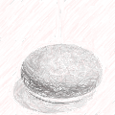
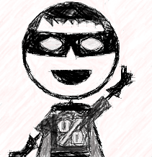
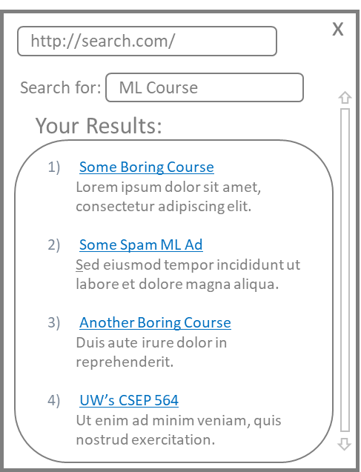
Ranking Flow
Text
Speech
Movie
Product
Content
Topic
Parameters
Augmentation
Query Triggering
Query Engines
Query
Interpretation
Query
& Planning
Interact
Best
Answers
Task Specific Solutions
Domain Specific Answers
Focused (or Legacy) Indexes
Ranker
Top N
Answers
Maximize objective
History, user, context, etc…
User Experience

Slide 17
One way of Evaluating Ranking: Mean Average Precision
$$AveP(q)=\frac{\sum_{i=i}^{N}{({Precision}_{@i} ∗IsRelavant\left(i\right))}}{\#Relevant}$$
$$Q=Test Queries$$
A
A
$$(1.0 ∗1)$$
Scores from
Ranking Algorithm
.5
$$MAP= \frac{\sum_{q∈Q}{AveP(q)}}{|Q|}$$
$$+$$
A
B
$$(0.5 ∗0)$$
.9
$$+$$
B
C
$$(0.33∗0)$$
$AveP=\frac{1.5}{2}$ = 0.75
A
.8
$$+$$
Query
B
A
$$(0.5∗1)$$
.2
$$+$$
C
C
$$(0.4∗0)$$
.4
$$+$$
Many other options:
Mean Reciprocal Rank
Precision @k
Clickthrough Rate
User Outcomes
And etc…
C
B
$$(0.33∗0)$$
.7
If:
Possible
Answers
Ranked
Answers
Ranker put both As @ top $AveP=1$
Ranker put both As @ end $AveP\sim .18$

Slide 18
Places Intelligence can Live
Where it Lives | Latency in Updating | Latency in Execution | Cost of Operation | Offline?
Static in Product | Poor | Excellent | Cheap | Yes
Client Side | Variable | Excellent | Based on update rate | Yes
Server-Centric | Good | Internet Roundtrip | Can be high | No
Back-end | Variable | Variable | Variable | Partial
Hybrid | ?? | ?? | ?? | ??

Slide 19
Basic Neural Network Structure
Hidden Node
$$P(eyeOpened)$$
$$P(leftEye)$$
$$P(glasses)$$
576 Pixels
(Normalized)
$$P(child)$$
Input Layer
Hidden Layer
Output Layer

Slide 20
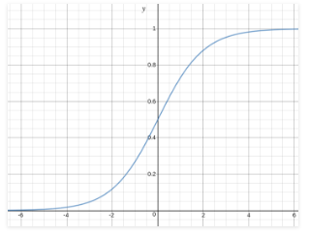
Example of Predicting with Neural Network
$$w_{0}$$ | 0.5
$$w_{1}$$ | -1.0
$$w_{2}$$ | 1.0
0.0
~0.5
$$x_{1}$$ | 1.0
$$x_{2}$$ | 0.5
1.5
$$P\left(y=1\right)=\sim 0.82$$
~0.75
1.0
$$w_{0}$$ | 0.25
$$w_{1}$$ | 1.0
$$w_{2}$$ | 1.0
$$w_{0}$$ | 1.0
$$w_{1}$$ | 0.5
$$w_{2}$$ | -1.0

Slide 21
Backprop Example
Forward Propagation
Back Propagation
Update Weights
$$w_{0}$$ | 0.5
$$w_{1}$$ | -1.0
$$w_{2}$$ | 1.0
$$∝=0.1$$
$$δ_{h1}$$
$$δ_{o}=y^{^}(1−y^{^})(y−y^{^})$$
~0.5
$$δ_{o}=0.027$$
$$δ_{o}$$
~0.82
$$x_{1}$$ | 1.0
$$x_{2}$$ | 0.5
$$y$$ | 1
Error = ~0.18
$$w_{0}$$ | 0.25
$$w_{1}$$ | 1.0
$$w_{2}$$ | 1.0
~0.75
${∆w}_{i}=∝δ_{next}x_{i}$
$$δ_{h2}$$
${∆w}_{i}=∝δ_{next} x_{i}$
$$w_{0}$$ | 1.0
$$w_{1}$$ | 0.5
$$w_{2}$$ | -1.0
$${∆w}_{0}=0.0027$$
$${∆w}_{1}=0.0013$$
$${∆w}_{2}=0.0020$$
${∆w}_{0}=0.0$005
${∆w}_{1}=0.0$005
${∆w}_{2}=0.000$25
$$δ_{h}=o_{h} (1−o_{h})\sum_{kεOutputs}{w_{kh}δ_{k}}$$
$$δ_{h2}=.005$$

Slide 22
Backprop Algorithm
Initialize all weights to small random number (-0.05 – 0.05)
While not ‘time to stop’ repeatedly loop over training data:
Input a single training sample to network and calculate $o_{u}$for every neuron
Back propagate the errors from the output to every neuron
$δ_{o}=y^{^}(1−y^{^})(y−y^{^})$
$δ_{h}=o_{h} (1−o_{h})\sum_{kεOutputs}{w_{kh}δ_{k}}$
Update every weight in the network
${∆w}_{i}=∝δ_{next}x_{i}$
$w_{i}=w_{i }+ {∆w}_{i}$
Stopping Criteria:
# of Epochs (passes through data)
Training set loss stops going down
Accuracy on validation data

Slide 23
Neural Network Architectures/Concepts
Fully connected layers
Convolutional Layers
MaxPooling
Activation (ReLU)
Softmax
Recurrent Networks (LSTM & attention)
Embeddings
Residual Networks
Batch Normalization
Dropout

Slide 24
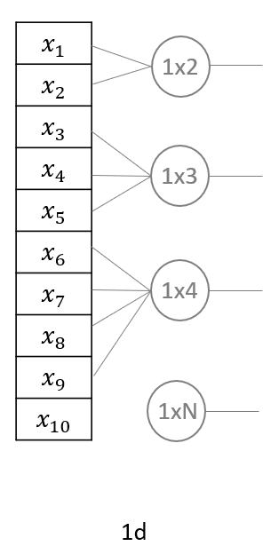
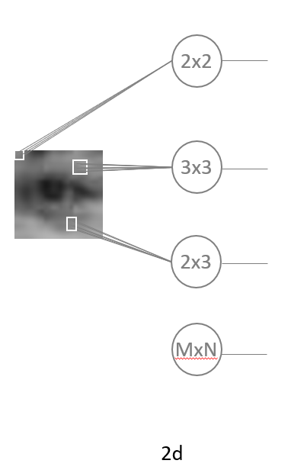
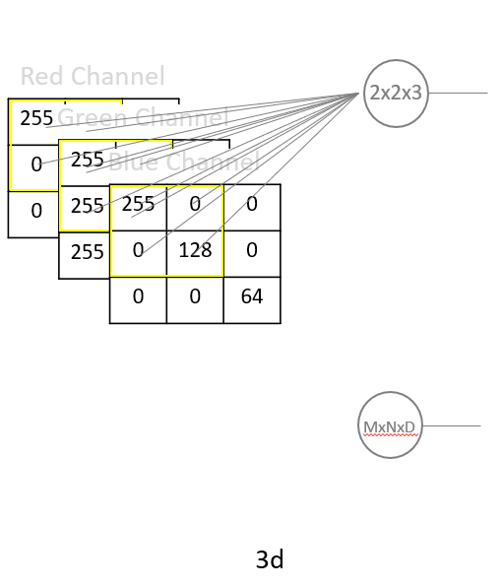
Convolutional Layer
$$x_{1}$$ | 1.0
$$x_{2}$$ | 0.5
$$x_{3}$$ | 0.25
$$x_{4}$$ | 0.6
$$x_{5}$$ | 0.33
$$x_{6}$$ | 0.12
$$x_{7}$$ | 0.9
$$x_{8}$$ | 1.0
$$x_{9}$$ | 0.44
$$x_{10}$$ | 0.5
$$y$$ | 1.0
$$a_{1}$$ | 0
$$a_{2}$$ | 0.25
$$a_{3}$$ | 0.85
$$a_{4}$$ | 0.23
$$a_{5}$$ | 0.29
$$a_{6}$$ | 1.28
$$a_{7}$$ | 0.6
$$a_{8}$$ | -0.06
$$a_{9}$$ | 0.56
$$a_{10}$$ | 0.0
$$w_{0}$$ | 0.5
$$w_{1}$$ | -1.0
$$w_{2}$$ | 1.0
Pad | 0.0

Slide 25
Backprop with Convolutional Layers
Forward Propagation
Back Propagation
Update Weights
Shared
Weights
$$w_{0}$$ | 0.5
$$w_{1}$$ | -1.0
$$w_{2}$$ | 1.0
$${∆w}_{0}=∝δ_{1,2}+ ∝δ_{2,3}+ ∝δ_{3,4}+ ∝δ_{4,p}$$
$$δ_{o}=y^{^}(1−y^{^})(y−y^{^})$$
$${∆w}_{1}=∝δ_{1,2}x_{1 }+ ∝δ_{2,3}x_{2 }+ ∝δ_{3,4}x_{3}+ ∝δ_{4,p}x_{4}$$
$$δ_{h}=o_{h} (1−o_{h})\sum_{kεOutputs}{w_{kh}δ_{k}}$$
$${∆w}_{2}=∝δ_{1,2}x_{2 }+ ∝δ_{2,3}x_{3 }+ ∝δ_{3,4}x_{4}$$
$$δ_{1,2}$$
${∆w}_{i}=∝δ_{next}x_{i}$
$$x_{1}$$ | 1.0
$$x_{2}$$ | 0.5
$$x_{3}$$ | 0.25
$$x_{4}$$ | 0.6
$$y$$ | 1.0
$$δ_{2,3}$$
$$δ_{o}$$
$$y^$$
$$δ_{3,4}$$
$$δ_{4,p}$$
Unrolled
1x2
Filter
Pad | 0.0
Convolutional Layer

Slide 26
Basic Machine Learning Math Concepts
Sigmoid
Log Loss
Bayes Theorem
Entropy
L1 vs L2 Norm/regularization
Mean Squared Error
Binary Cross Entropy
Softmax
$$Loss\left(testSet\right)= \frac{1}{n}\sum_{i}^{n}{{\left({\hat{y}}_{i}−y_{i}\right)}^{2}}$$
$$H\left(S\right)=−\sum_{i∈\{y\}}{p\left(y=i\right)∗\log_{2}(p\left(y=i\right))}$$
$$F_{i}(<x_{1},…,x_{N})=\frac{e^{x_{i}}}{\sum_{j}^{N}{e^{x_{j}}}}$$
$$F\left(d_{1},d_{2}\right)=\sqrt{d_{1}^{2}+ d_{2}^{2}}$$
$$F\left(z\right)= \frac{1}{1+ e^{−z}}$$
$$Loss\left(y^{^}, y\right)=−y ∗\log\left(y^{^}\right)−\left(1 −y\right)∗log(1 −y^{^})$$
$$P\left(A | B\right)=\frac{P\left(B | A\right)P(A)}{P(B)}$$
F$\left(d_{1}, d_{2}\right)={|d}_{1}|+|d_{2}|$

Slide 27
Reinforcement Learning
Agent
Reward
State
Action
Environment
Markov Decision Process (environment)
Policy
(agent’s behavior)
Discrete-time stochastic control process
Each time step, $s$:
Agent chooses action $a$ from set $A_{s}$
Moves to new state with probability:
$P_{a}(s, s^{′})$
Receives reward: $R_{a}(s, s^{′})$
Every outcome depends on $s$ and $a$
Nothing depends on previous states/actions
$π(s)$ – The action to take in state $s$
Goal maximize:$\sum_{t=0}^{∞}{γ^{t}R_{a_{t}}(s_{t},s_{t+1})}$
$a_{t}= π\left(s_{t}\right)$
$0≤γ<1$ – Tradeoff immediate vs future
$V^{π}\left(s\right)= \begin{matrix}\sum_{s^{′}}{P_{π\left(s\right)}(s,s^{′})} ∗ \\ ({ R}_{π\left(s\right)}\left(s,s^{′}\right)+γV^{π}\left(s^{′}\right) )\end{matrix}$

Slide 28
Q learning
Learn a policy $π(s)$ that optimizes $V^{π}\left(s\right)$for all states, using:
No prior knowledge of state transition probabilities: $P_{a}(s, s^{′})$
No prior knowledge of the reward function: $R_{a}(s, s^{′})$
Approach:
Initialize estimate of discounted reward for every state/action pair: $\hat{Q}\left(s,a\right)=0$
Repeat (for a while):
Take a random action $a$ from $A_{s}$
Receive $s^{′}$ and $R_{a}(s, s^{′})$ from environment
Update $\hat{Q}(s,a)$ = $(1−∝_{v}){\hat{Q}}_{n−1}(s,a)$ + $∝_{v}[{ R}_{a}\left(s, s^{′}\right)+γ\max_{a^{′}}{{\hat{Q}}_{n−1}\left(s^{′},a^{′}\right)} ]$
${ R}_{a}\left(s, s^{′}\right)+γ\max_{a^{′}}{{\hat{Q}}_{n−1}\left(s^{′},a^{′}\right)}$
$$∝_{v}= \frac{1}{1+visits(s,a)}$$
Exploration Policy: $P\left(a_{i},s\right)=\frac{k^{\hat{Q}(s,a_{i})}}{\sum_{j}{k^{\hat{Q}(s,a_{j})}}}$

Slide 29
Orchestrating a Machine Learning System
Machine Learning system live over time
Many reasons they will need to change
People who built the system aren’t always best to run it
Successful Orchestration
Achieve Objectives over Time
Balance: Experience, Intelligence, & Objective
Mitigate Mistakes Effectively
Scale Efficiently
Degrade Slowly
Tools for Orchestration
Monitoring Success Criteria
Inspecting Interactions
Balancing the Experience
Overriding the Intelligence
Creating new Intelligence

Slide 30
On Being Bayesian

Slide 31
Approaching your Machine Learning Project
Make sure an Intelligent System is right
Define what success looks like
Design Experience that achieves your goals
Plan for getting data from the user interactions
Plan to verify your intelligent experience
Decide where your intelligence will live
Design your intelligence runtime
Plan for intelligence management
Plan for telemetry
Prepare to evaluate your intelligence
Decide how you will organize your intelligence
Set up your intelligence creation process
Plan for orchestration throughout your Intelligent System's lifecycle
Prepare to identify and deal with mistakes
Get ready for abuse
Have fun and change the world...

Slide 32
Thank You!
Keep in touch: ghulten@hotmail.com or on LinkedIn
Let me know if you end up doing ML in practice
Send me constructive criticism on the course

